Slide 1
Welcome to our capstone proposal presentation

Slide 2
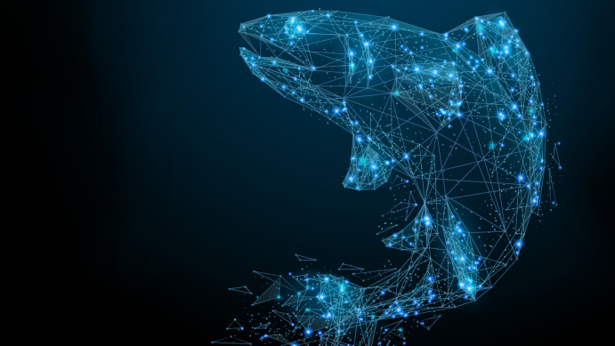
Smart Aquafarming: Revolutionizing Fish Farming with IoT and AI

Slide 3
Project Member & Supervisor
Md. Shakibul Islam Ramim
ID: 2125051063
Nahian Islam Emon
ID: 2125051114
Fazlay Rabbi
ID: 2125051070
Sumi Akter
ID: 2125051037
Supervised by:
Dr. Md. Ashraful Islam
Professor
Department of computer Science and Engineering (CSE)
Deen
Faculty of Science and Engineering
University of Information Technology and Sciences

Slide 4
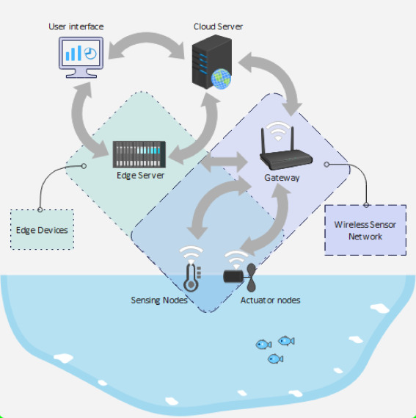
Introduction
Smart Fishery
Benefits of Smart Fishery.
Applications of Smart Fishery
Water Quality Monitoring
Disease control & monitoring
Controlled Environmental Factors
Push notifications through application of different state…
Profit prediction
Working with Smart Fishery

Slide 5
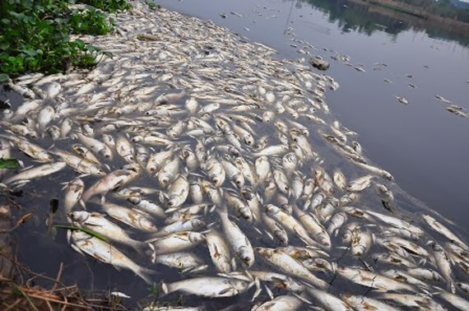
Problem Statement
Limited Water Quality Control
Inefficient Feed Utilization
High Disease Prevalence
Environmental Impact
Inconsistent Fish Size and Quality
Lack of Integrated Monitoring
Energy loss and high costs.
Labor cost

Slide 6
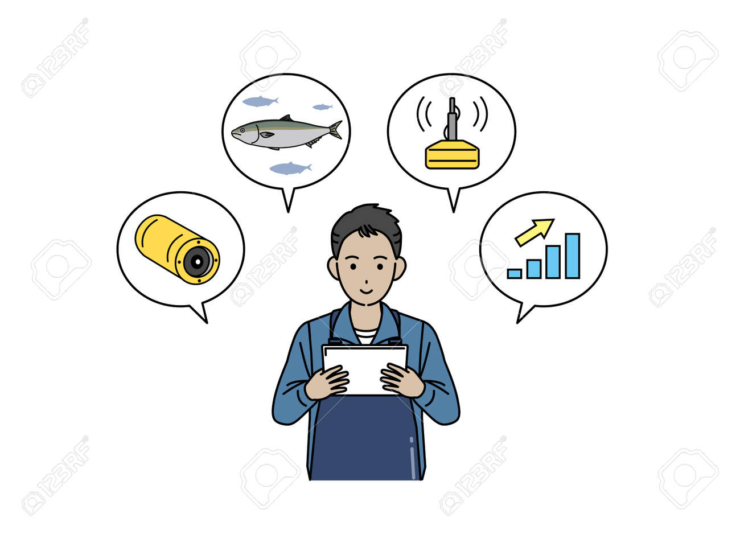
Objective
Optimize Water Quality Management.
Maximize Feed Efficiency.
Enhance Disease Detection and Prevention.
Enable Continuous Monitoring and Reporting.
Increase Productivity and Yield.

Slide 7
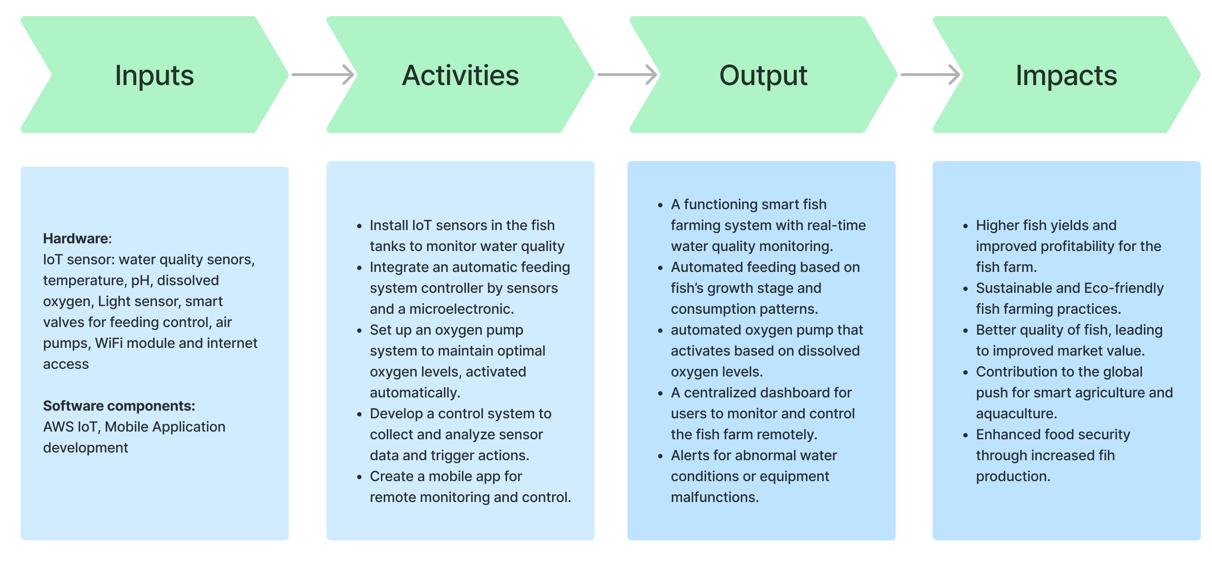
Result Framework

Slide 8
Background research
IoT sensors can measure real-time water quality monitoring thus reducing fish mortality by 30%. [1]
Smart systems optimize feeding schedules, reducing feed west and cutting feeding costs by 15-20% [2].
Automated control of water and oxygen reduces energy use by 25%, improving sustainability.[1]
IoT data helps predict growth, optimize harvests, and reduce operational costs by 10-15%[2].
IoT based smart fishery can minimizes pollution and chemical overuse, porting eco-friendly fish farming[3].

Slide 9
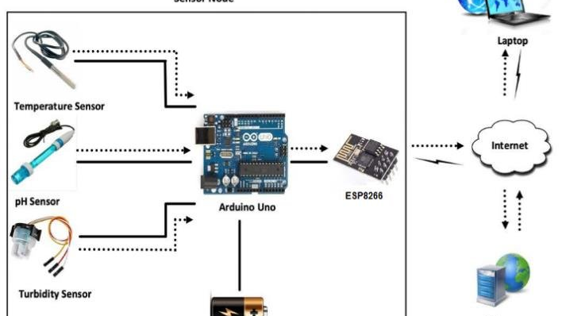
Methodology
Project Planning
Define Objectives , Research Required, Budget Estimation
Selection of IoT Components
Sensor, Controllers, Communication Protocols, Power Supply.
System Design and Architecture
Design Network Infrastructure, Develop Control Logic, Cloud or Local Server Setup User Interface Development
Installation of Sensors and Devices
Deploy Sensors in the Pond/Tank, Connect Sensors to Microcontrollers
Software Development
Firmware Development, Data Visualization Platform, Alert Systems
Testing and Calibration
Sensor Calibration, System Testing
Deployment and Monitoring
Full system deployment, Monitor Performance

Slide 10
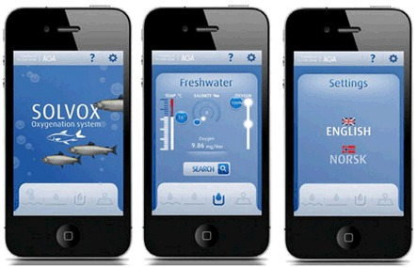
Expected outcomes
Functional Prototype of Smart fishery
Al-Driven Early Disease Detection and Predictive analyses
Improved Fish Health and Growth Rates
Reduced Feed Waste, Costs and Improve Efficiency.
Performance Evaluation Report
A website to buy and sell the fish.

Slide 11
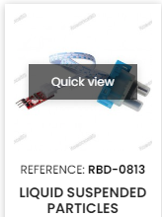
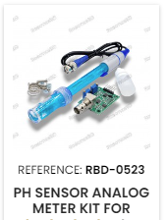
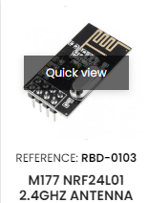
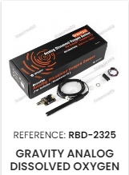
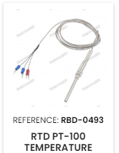
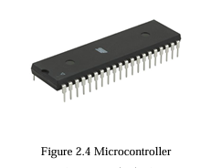
Resource Required
Hardware Component:
IoT Sensors: O2 sensor, temperature and Ph sensor, light sensors
Actuators: Smart valves for feeding control, Air pumps
Wifi module and internet access.
Software Components:
Cloud Computing Platform: AWS IoT
AI Frameworks: TensorFlow or PyTorch for ML model, DataSets
Mobile Application Development

Slide 12
Estimated Budget
Hardware and Software
No | Item Name |  | Price per unit | Quantity | Total amount BDT
1 | Bread Board |  | 420 | 1 | 420
2 | Sensors |  | 1000 | 4 | 4000
3 | Wi-Fi module |  | 530 | 1 | 530
4 | Electrical Components |  | 1050 | 1 | 1050
5 | Micro Controllers |  | 1500 | 2 | 3000
6 | Others |  | 2270 | 1 | 2500
 |  |  |  | Total= | 12,500

Slide 13
Preliminary timeline
1. Project Planning
1 month
Define project scope and object
2. System Design
1 month
- Design system architecture
3. Development
1 Month
Develop and integrate IoT
4. Testing
1 Month
-Conduct Field tests
5. Deployment
1 Month
- Conduct Field tests
6. Training and Documentation
1 Month
Collect performance data and user feedback
7. Evaluation, Optimization and Final Reporting
2 Month
-collect performance data and user feedback
Compile final project report and present findings

Slide 14
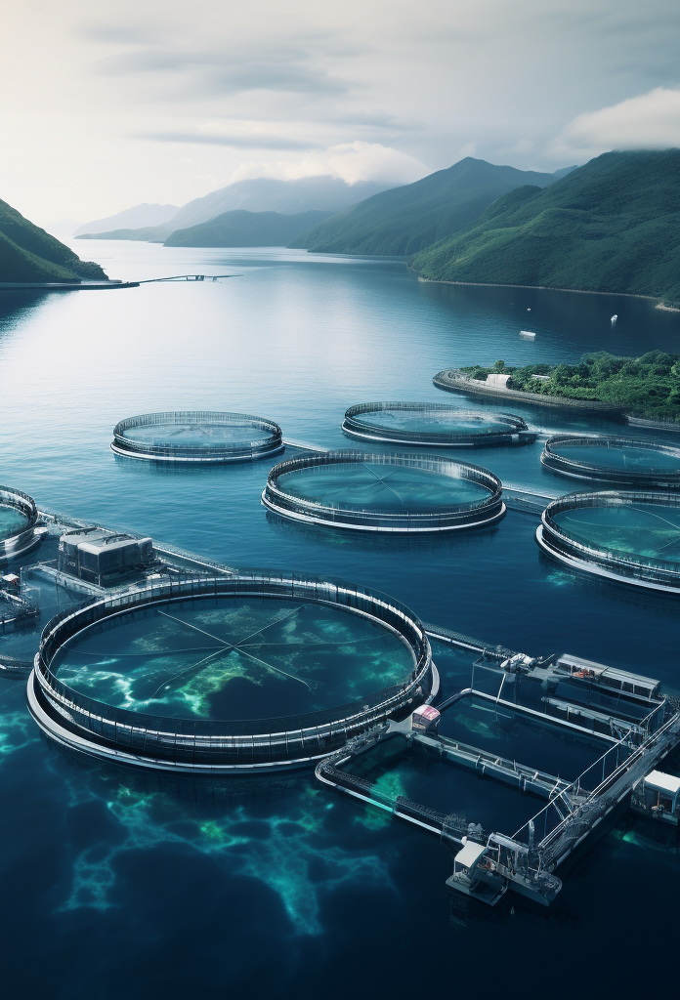
Conclusion
In Smart Fishery project we will try to successfully integrate IoT and AI technologies to revolutionize traditional fish farming.
Smart Fishery enables farmers to make decisions, optimize resources, and improve fish quality.
Smart Fishery represents a significant step toward the future with technology for smarter, more efficient, and environmentally sustainable farming.

Slide 15
References
[1]Kiruthika, S. Usha, S. R. Kanaga, and R. Jaichandran. "IOT based automation of fish farming." J. of Adv. Res. in Dynam. Control Syst 9.1 (2017).
[2]Chen, Chiung-Hsing, et al. "IoT-based fish farm water quality monitoring system." Sensors 22.17 (2022): 6700.
[3]Nocheski, S., and Andreja Naumoski. "Water monitoring IoT system for fish farming ponds." Industry 4.0 (2018).

Slide 16

Any Questions ?

Slide 17

Thank You
A man is as big as his dream
- prof. Abdullah Abu Sayeed

